Slide 1


Analyzing eCommerce Business Performance with SQL
Created by:
Muhammad Cikal Merdeka
Email : mcikalmerdeka@gmail.com
LinkedIn : linkedin.com/in/mcikalmerdeka
Github : github.com/mcikalmerdeka
Dedicated entry-level data scientist with analytical and experimental background of Physics. My graduation 2023, a pivotal year marked by significant advancements in artificial intelligence with the introduction of GPT-4 and other generative AI models, has fueled my curiosity and excitement to delve into the field of data. I have comprehensive grasp of data science methodology from business understanding to modelling process with proficiency in Python, SQL, Tableau, Power BI, Looker Studio and other tools related to data analytics workflow from several coursework and bootcamps.

Slide 2


Overview
In a company, measuring business performance is crucial for tracking, monitoring, and evaluating the success or failure of various business processes. Therefore, this project will analyze the business performance of an eCommerce company, taking into account several business metrics such as customer growth, product quality, and payment methods.
In this project, data analysis and querying will be done using PostgreSQL, and visualization will be performed using Tableau.

Slide 3
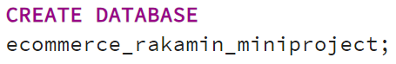
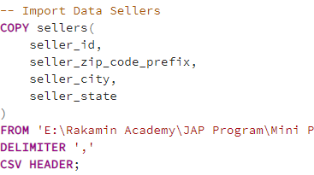
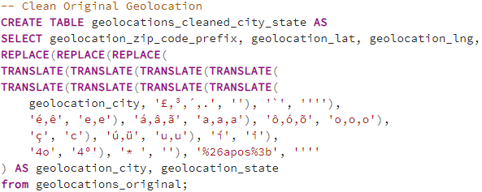
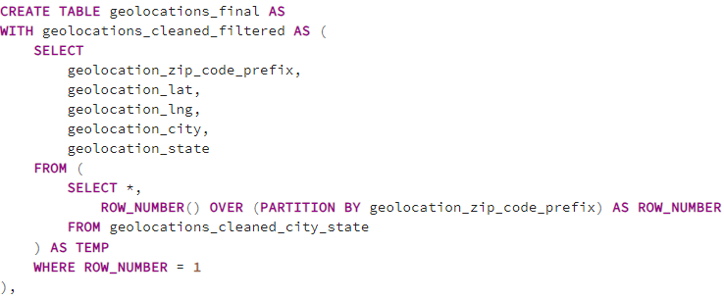
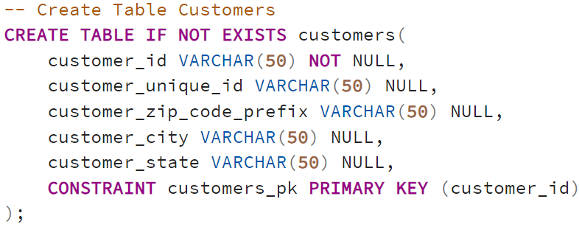
Data Preparation
Create Database & Tables
In this case we can create database by using CREATE DATABASE or pgAdmin 4 tools.
Here are some of the tables created
2. Import Data
Then we import the data using COPY or pgAdmin 4 tools
3. Data Cleaning
Data cleaning are mostly done in geolocations table where we change the special characters in City, drop duplicate rows, and input new geolocations form customers and sellers.
customers
order_reviews
geolocations
orders
order_items
products
order_payments
sellers
The full query can be found here

Slide 4
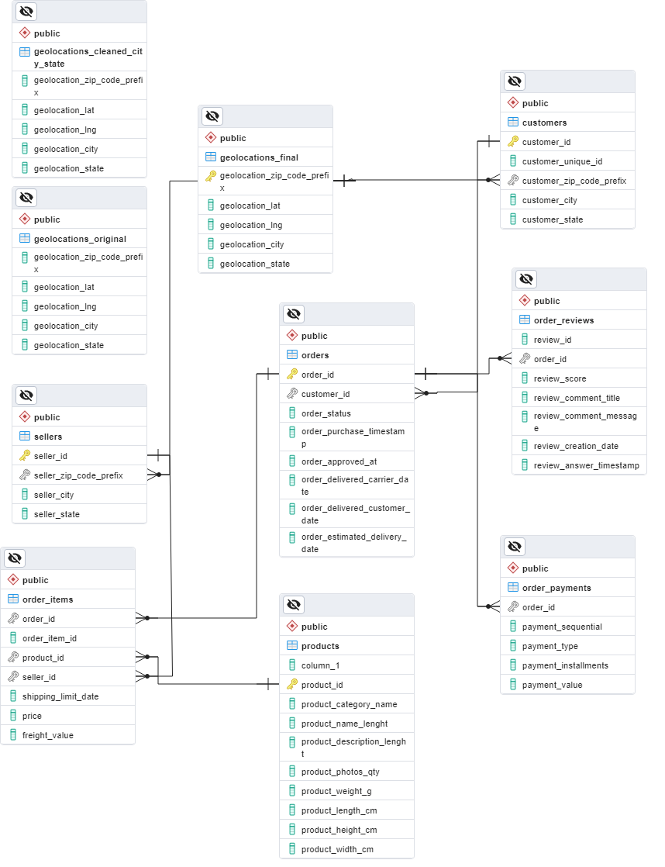
Data Preparation
4. Entity Relationship Diagram
ERD is created utilizing the Primary Key and Foreign Key of each table that we specified in the table making process, making them have relationship of Parent and Child Table as shown in the diagram on the right.
ERD can be found here

